Slide 1
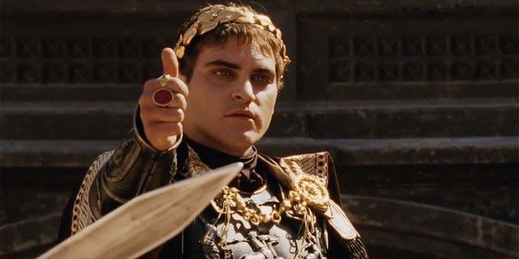


Public speaking – How to win the crowd?
Nikola Ilic
@DataMozart

Slide 2
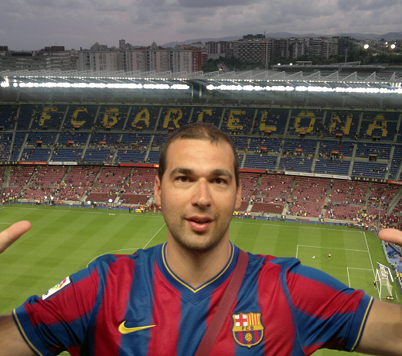



Nikola Ilic
BI Developer @ITSP Services GmbH
Data-mozart.com
@DataMozart
I'm making music from the data!
Power BI and SQL Server addict, blogger, speaker...
Father of 2, Barca & Leo Messi fan...

Slide 3




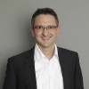
Transition from attendee to a presenter!
How it all started...
Practice makes perfection
Helpful people!
@DataMozart

Slide 4
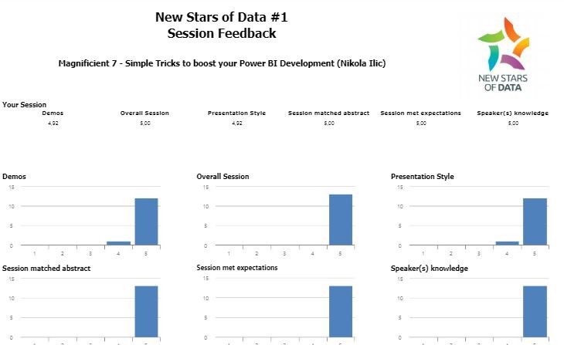
Feeling nervous is not a shame!
@DataMozart

Slide 5






My key takeaways
Try to find a mentor
Speaking is exhaustive
Insist on feedback
Plan time for audience questions
You‘re allowed to answer: „I don‘t know“...
Practice makes perfection
@DataMozart

Slide 6

My checklist
Session topic
Title & Abstract
Depth vs width
Know your audience
Demos
Technical check
@DataMozart

Slide 7
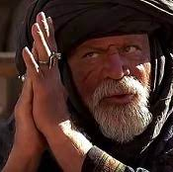
Winning the crowd!
„I was not the best because I killed quickly. I was the best because the crowd loved me.
Win the crowd and you will win your freedom..:“
@DataMozart

Slide 8
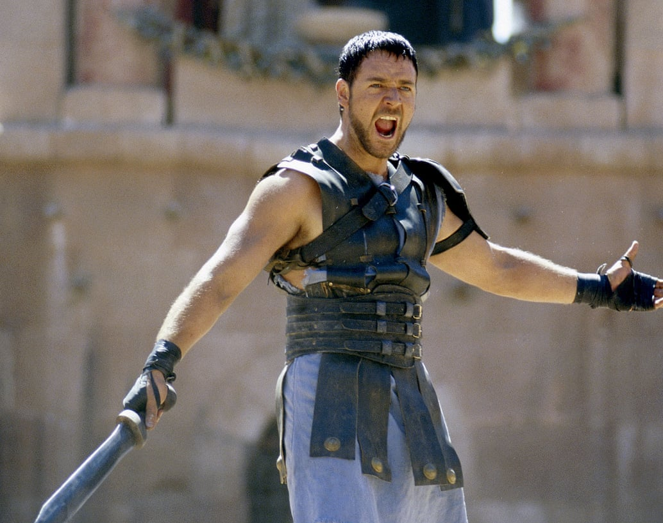
Thank you!
Audience feels the pleasure being there
Learning something new and useful
Provoke that „a-ha“ feeling
@DataMozart

